Slide 1


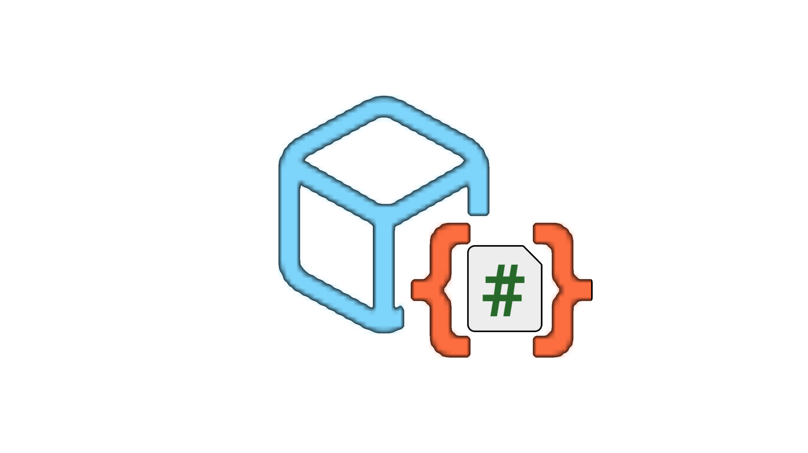
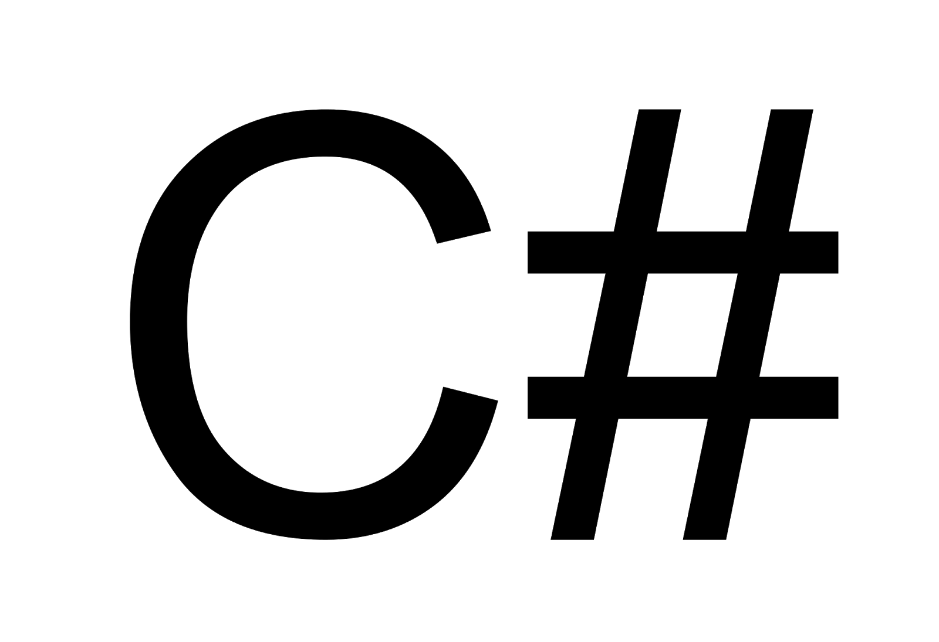



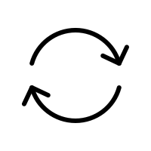




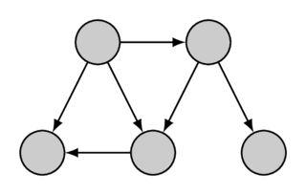





Scene
ScriptAnalyzer
GameObjects
Scene Interaction
Mapping
Mapping
Dependency Extraction
UnityDataAnalyzer
Prompt
MonoBehaviour Component
Asset Files
General LLMs
Script Files
Open-Source
XR Codebases
Extract
Add
CodeStuctureAnalyzer
Extracted JSON Files
Test-oriented Dependency Graph(TODG)
Script Files
Extract
Multi-run Conversation
Initial Prompt
Extracted TODG
Info Explanation
Test Info
Basic Prompt
Generated Test Plans
Test Plan
Prompt Template

Slide 2





Data Collection
Dependency Extraction
Unity Data Analyzer
Scene
ScriptAnalyzer
Asset Files
Open-Source
XR Codebases
Extracted JSON Files
Code Structure Analyzer
GameObjects
(Gobjs)
Scene Interaction
Mapping
Mapping
Script Files
Scene Modelling
LLM-based Test Plan Generation
Context-aware Conversation
Extracted TODG
MonoBehaviour Component
Prompt
Initial Prompt
Interactable GObjs
General LLMs
Child GObjs
Script Files
Info Explanation
Test Info
Scene Interaction Gobjs
Extract
Extract
Add
Mono
Comp
Prompt Design
Test-oriented Dependency Graph(TODG)
Basic Prompt
...
Prompt Templates
...
Test Plan
...
Test Plan Semantic Adaption
Runtime Scene Exploration
Text-to-C#
Task Data
Action Unit Parse
End
Yes
Action
Unit
Finish Testing?
No
Scene
Interact
Generated Test Plans
Structured Actions
VRAgent
AES
Parameters Binding
Action Execution Sequences (AES)
Action Type
Executable Interaction
Load
Action
Unit
Objects
Other

Slide 3
Data Collection
Dependency Extraction
Unity Data Analyzer
Scene
ScriptAnalyzer
Asset Files
Open-Source
XR Codebases
Extracted JSON Files
Code Structure Analyzer
GameObjects
(Gobjs)
Scene Interaction
Mapping
Mapping
Script Files
Scene Modelling
LLM-based Test Plan Generation
Context-aware Conversation
Extracted TODG
MonoBehaviour Component
Prompt
Initial Prompt
Interactable GObjs
General LLMs
Child GObjs
Script Files
Info Explanation
Test Info
Scene Interaction Gobjs
Extract
Extract
Add
Mono
Comp
Prompt Design
Test-oriented Dependency Graph(TODG)
Basic Prompt
...
Prompt Templates
...
Test Plan
...
Generated Test Plans

Slide 4

Parameters Binding
End
Yes
Action Type
Finish Testing?
Objects
No
Scene
Interact
Other
VRAgent
AES
Load
Action
Unit
Executable Interaction
Structured Actions
Action Execution Sequences (AES)
Action
Unit
Test Plan
C# Class
Test Plan Understanding and Adaptation
Runtime Scene Exploration Loop
Unity Object Identification and Bridging
Authoring Session
Runtime Session
ID Bridge
AES

